Slide 1

Hardware: Locomotions & Mechanical Design (2-ACTUATORS)
1714949

Slide 2
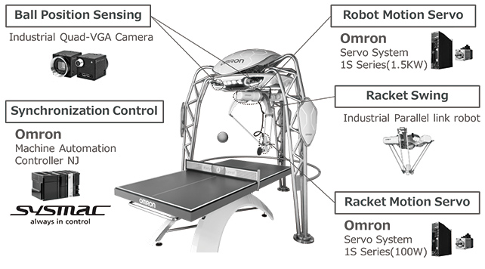
Stationary Robots
Omron forpheus robot:
To play table tennis with humans representing the harmony between humans and machines.
A function that recognizes the skills of human players and devises a strategy for keeping a rally going with a slight lead over the human player
Return shots precise and accurate enough to realize this strategy

Slide 3
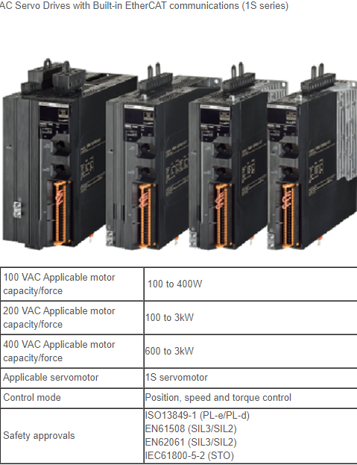
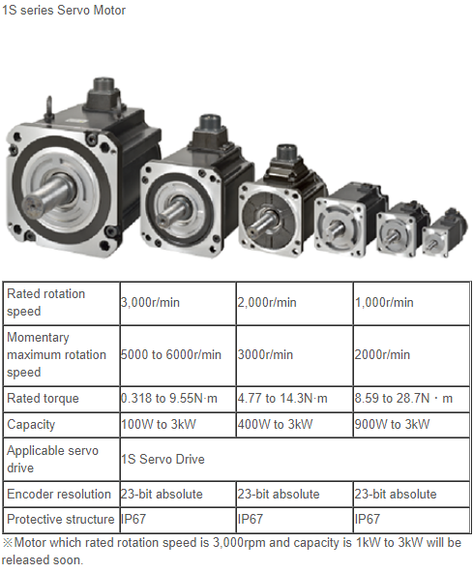

Omron forpheus robot: Components
Robot motion Servo: Specfications
Brand

Slide 4
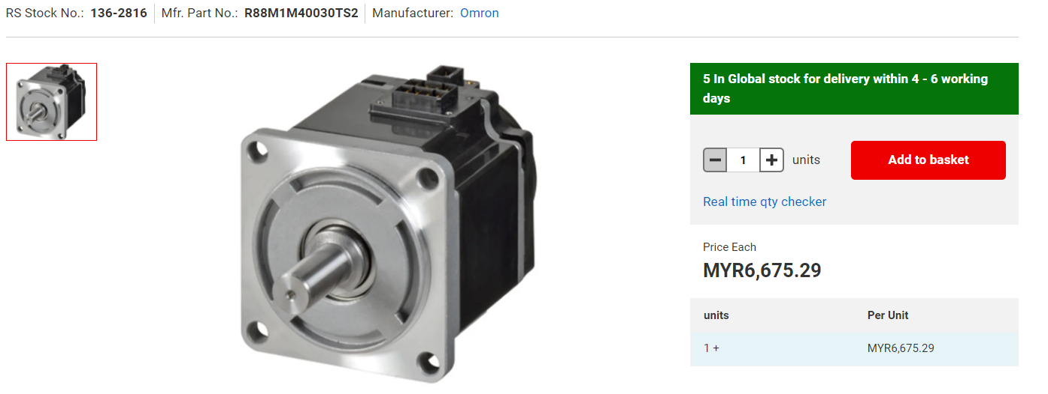
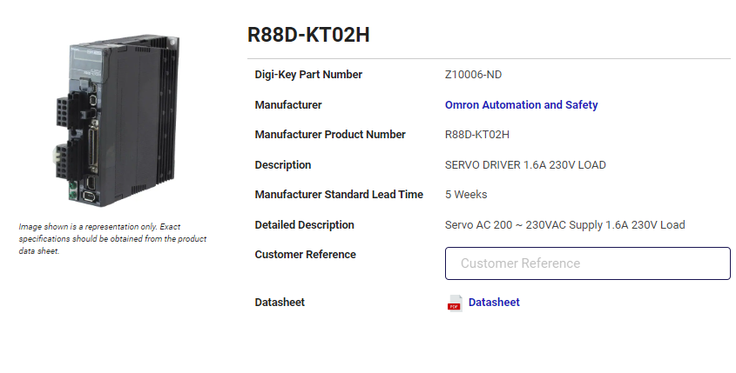
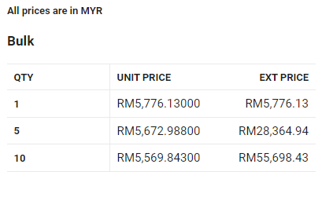
Price and Brand

Slide 5
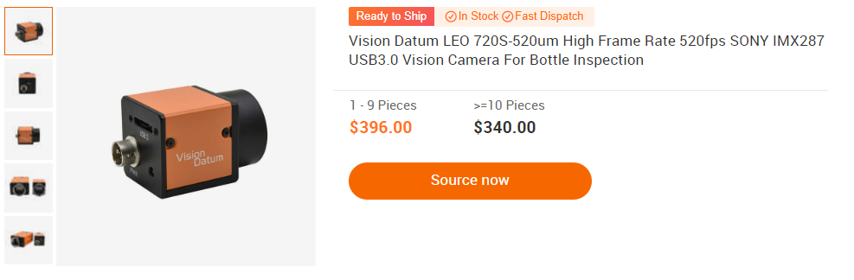
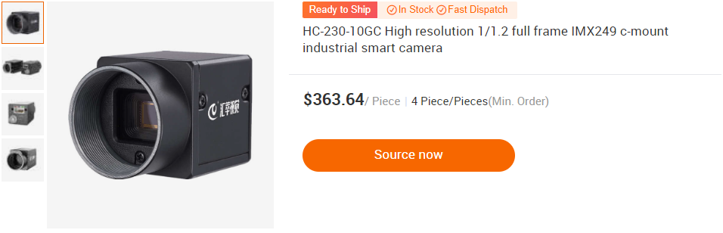
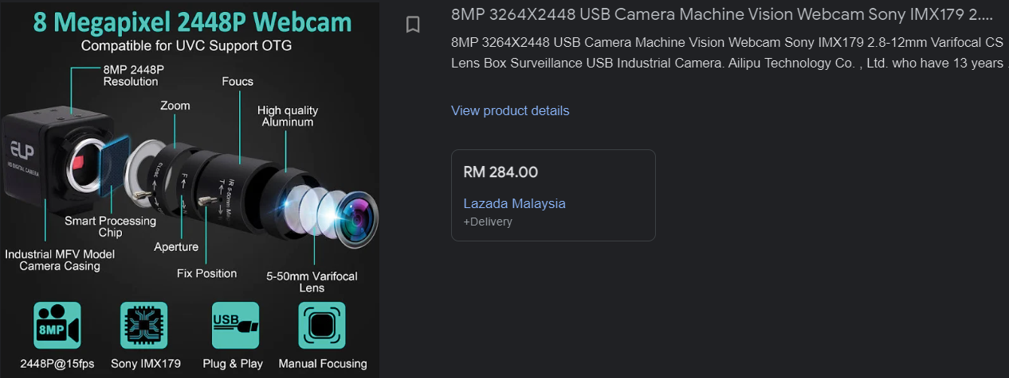
Quad-VGA industrial camera 80-fps price and brand

Slide 6
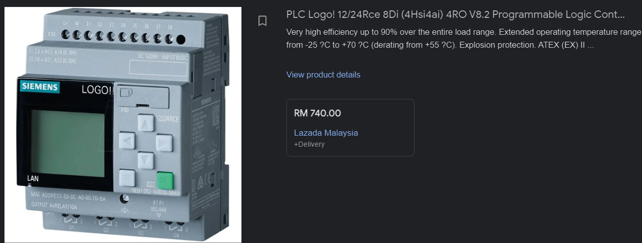
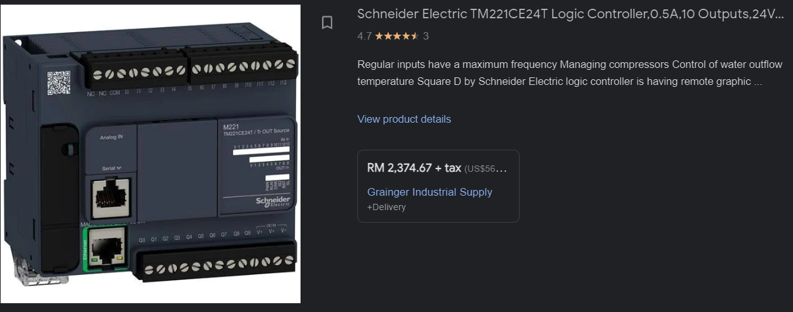
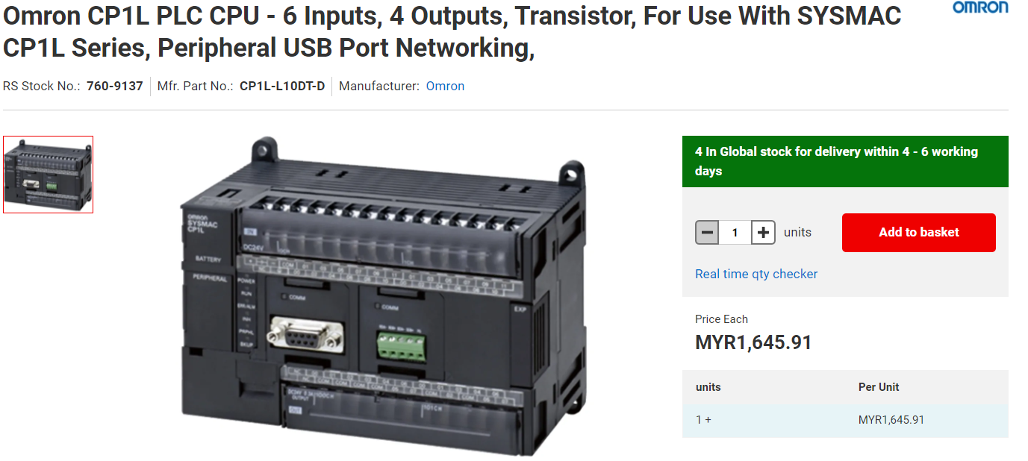
Machine Automation Controller Brind and price

Slide 7
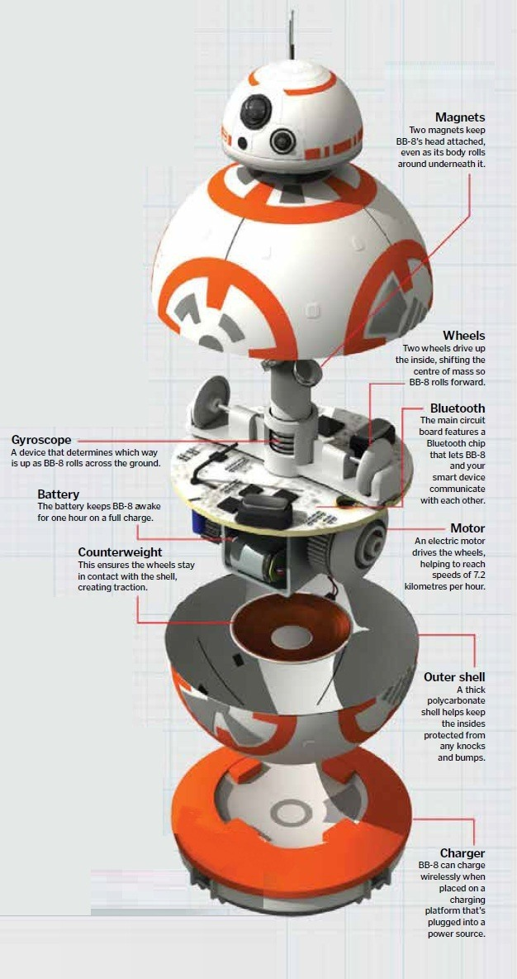
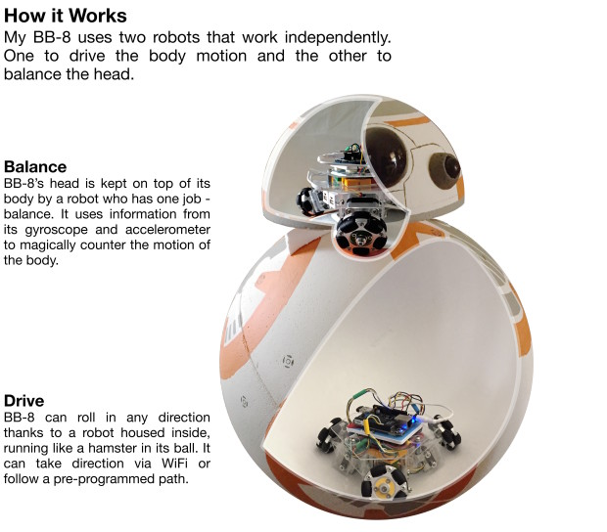
Wheeled Robots & Tracked Robots
Single wheel BB-8

Slide 8
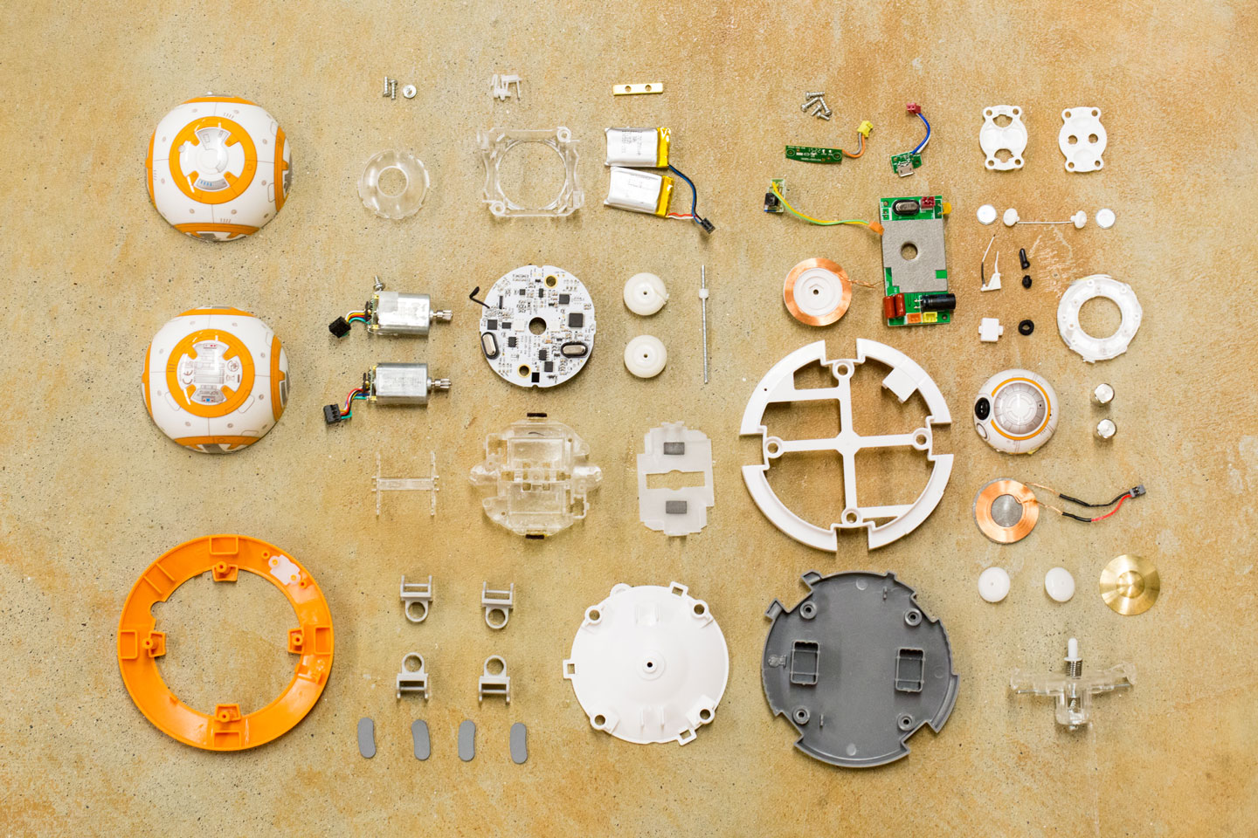
Single wheel BB-8: Hardware Components (Specification, Brands and Price)
Specifications:
Name: BB-8 Planet Boy Robot
Control range: About 5-10m
Size : About 20.5 * 13cm
Remote controller battery: 2 * AA battery (not included) Body battery: 4 * AA battery (not included)
Age level: Above 6 years old
Weight: About 481g There may be some deviation due to manual measurement.
Package Information:
Package size: 27 * 22 * 16cm / 10.6 * 8.6 * 6.3in Package weight: 906 / 2.0lb
Gift box package Package List: 1 * Spherical Shell 1 * Internal Electronic Components 1 * Remote Controller

Slide 9
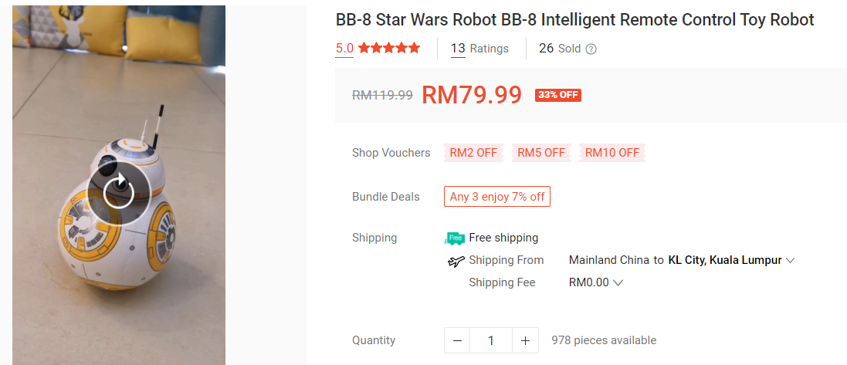
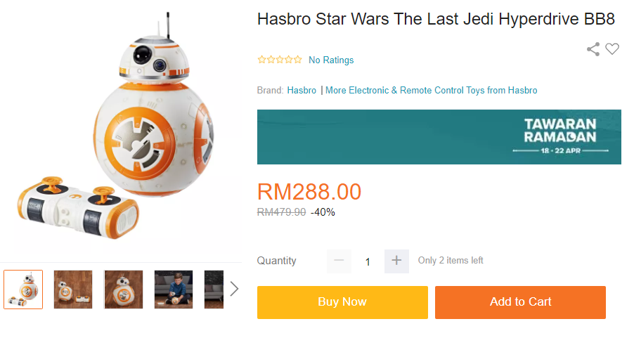
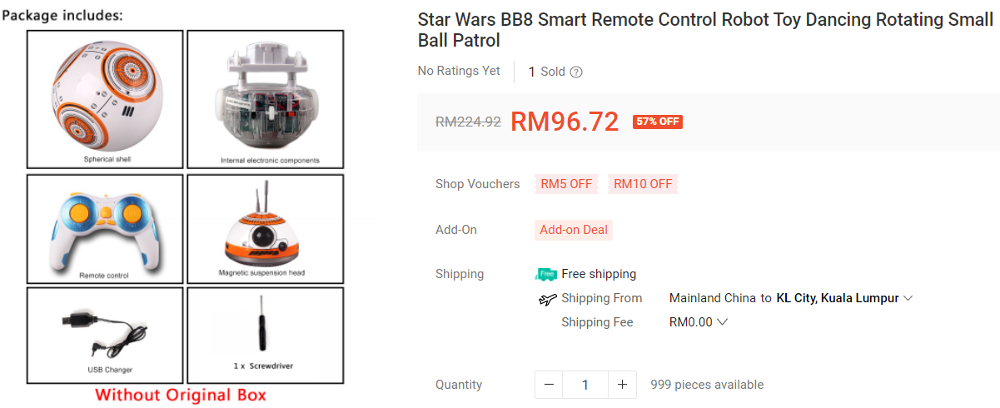

Slide 10
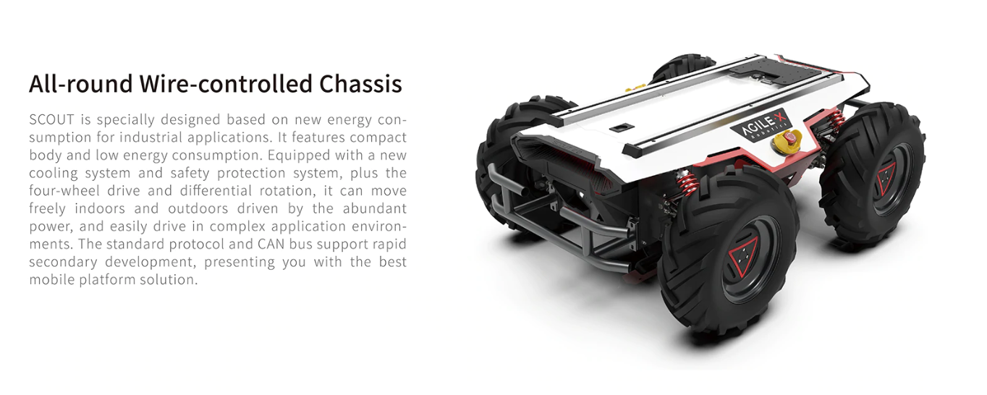
4WD Omni-Directional Mobile Robot

Slide 11
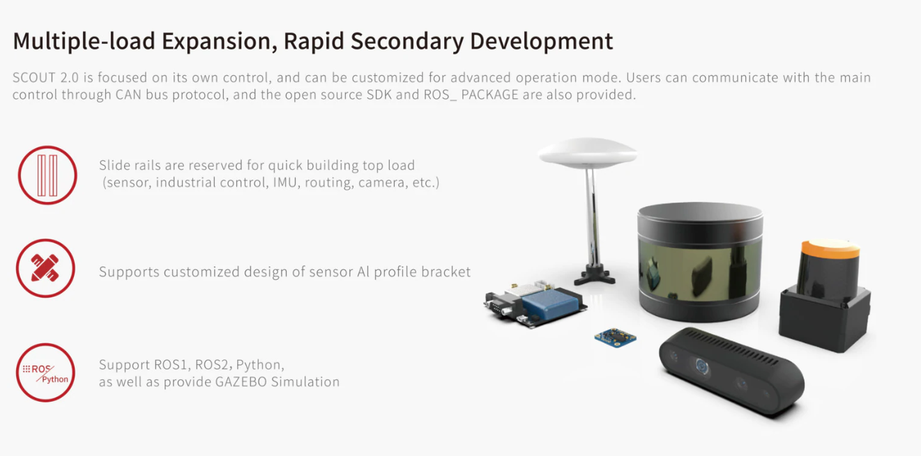

Slide 12
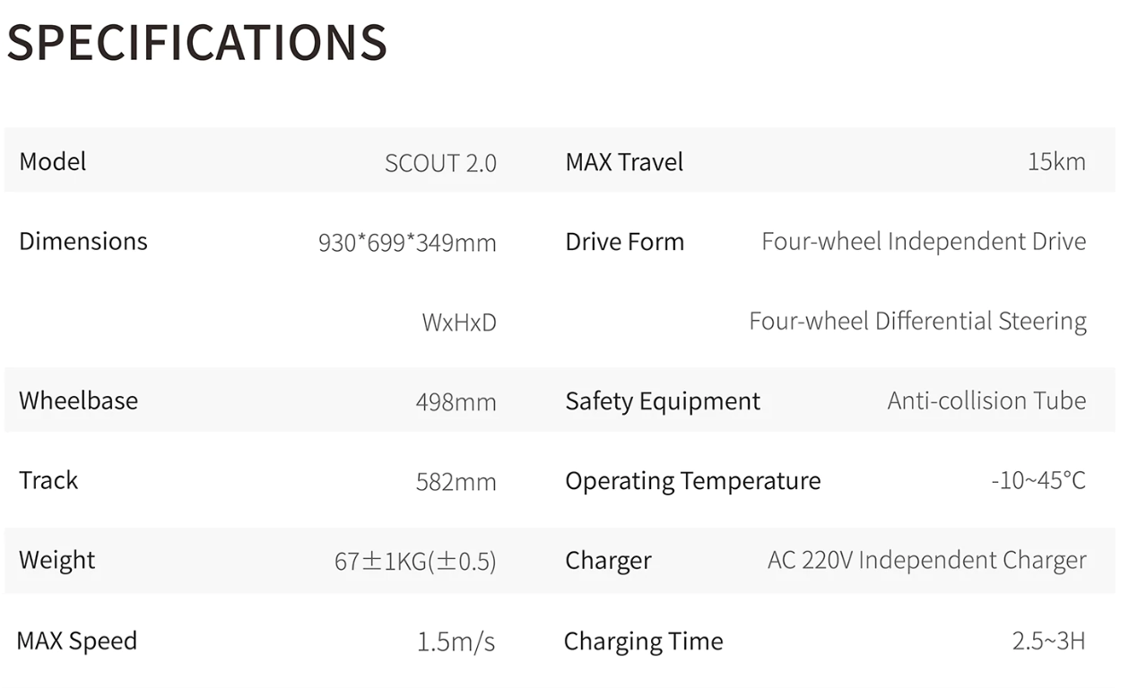
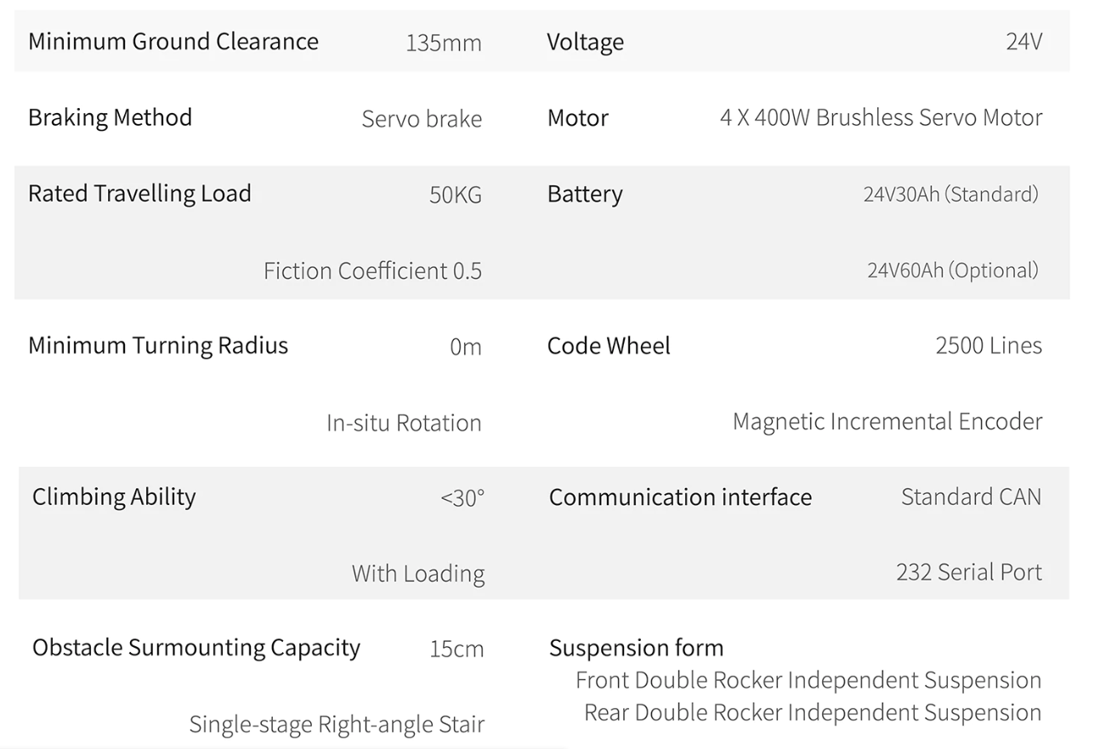

Slide 13
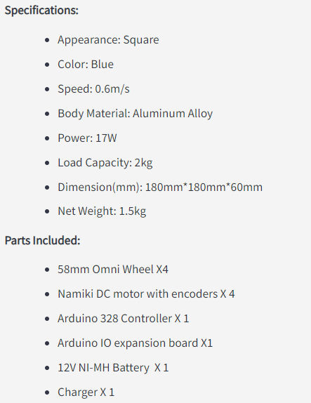
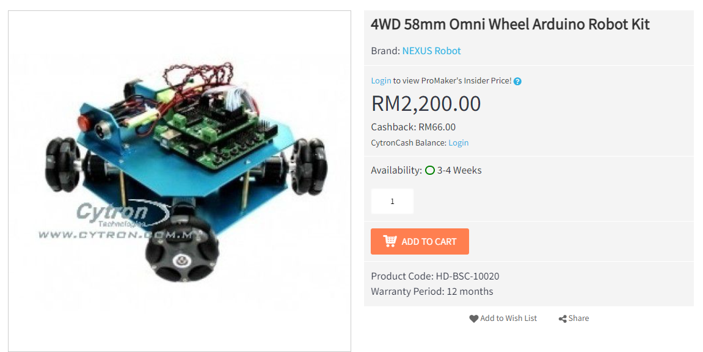

Slide 14
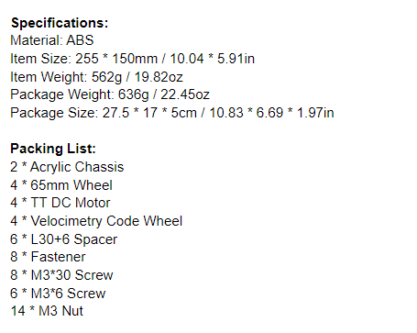
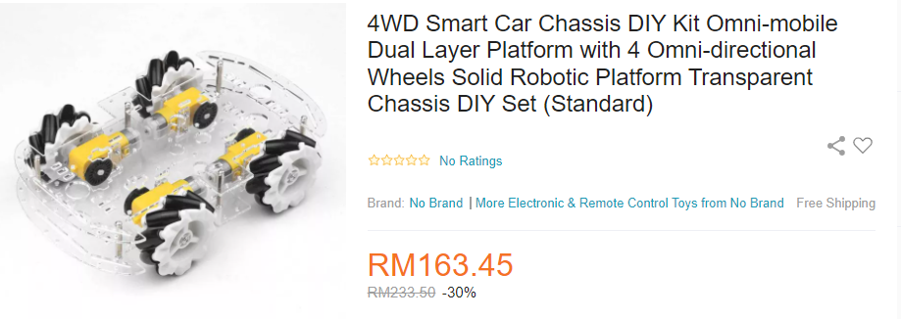

Slide 15
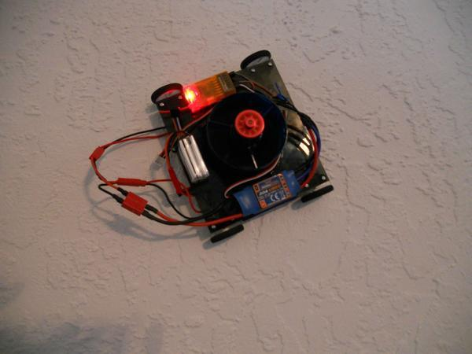
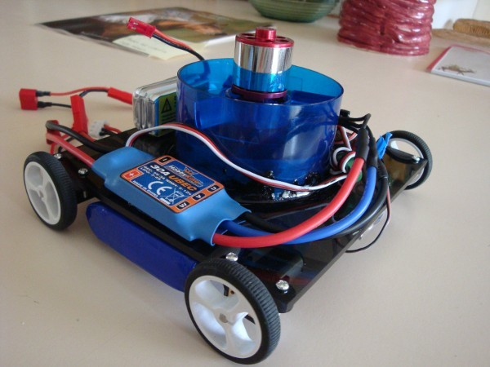
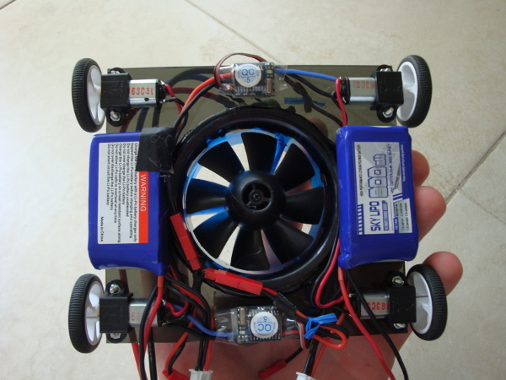
Wall Climbing Robot

Slide 16
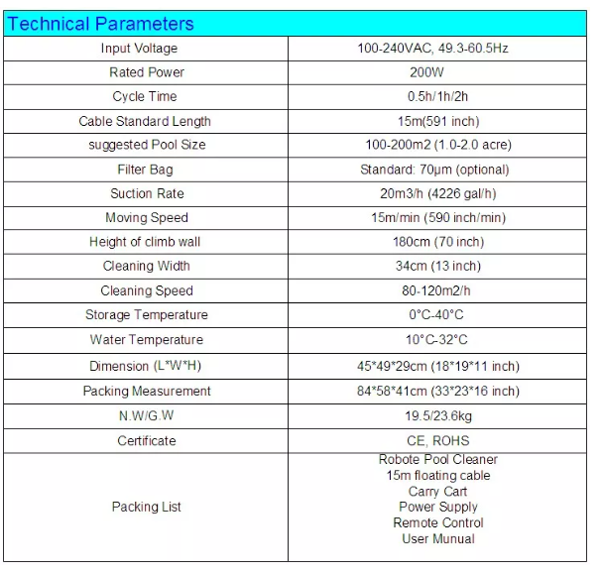
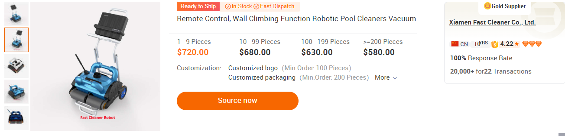

Slide 17
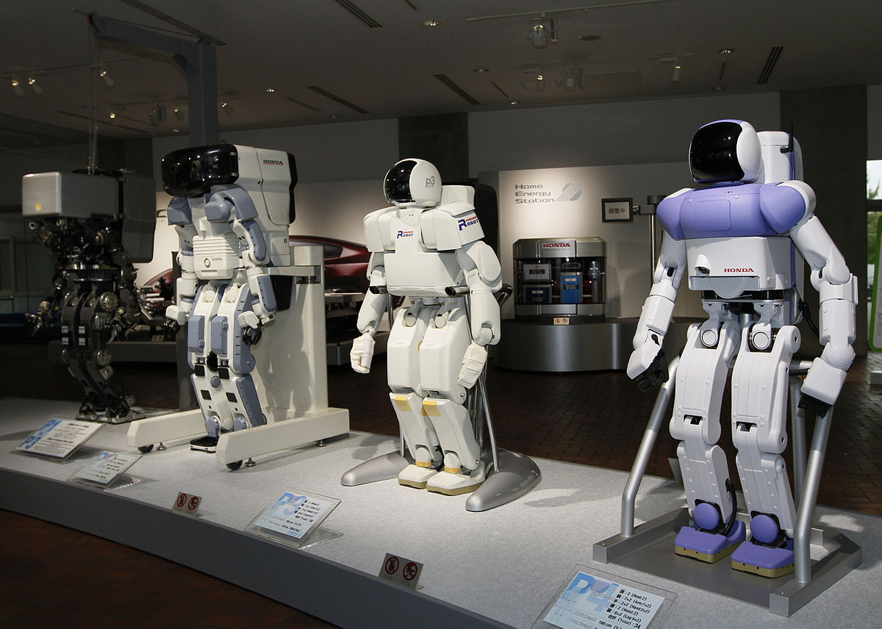
Humanoid Robot (BIOLOID)
is a robot resembling the human body in shape. The design may be for functional purposes, such as interacting with human tools and environments, for experimental purposes, such as the study of bipedal locomotion, or for other purposes. In general, humanoid robots have a torso, a head, two arms, and two legs, though some humanoid robots may replicate only part of the body, for example, from the waist up. Some humanoid robots also have heads designed to replicate human facial features such as eyes and mouths.

Slide 18
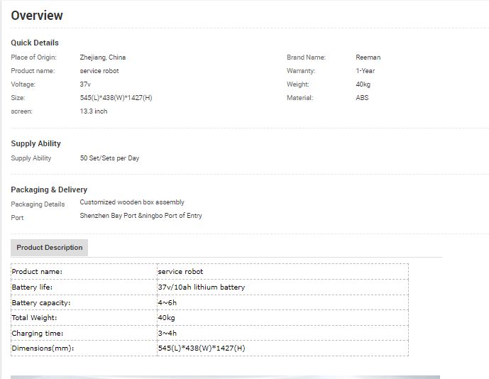
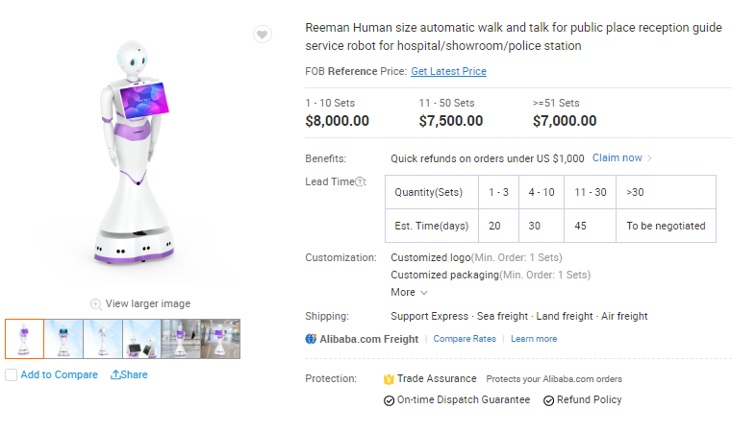
Humanoid Robot (BIOLOID) price and brand

